Slide 1


Module: Information & Data Literacy
Project: InDigital - Inclusive digital competence training for labor market risk groups
Project reference: 2022-1-BG01-KA210-VET-000084442
Learning Material for Adult Learners

Slide 2


Project Consortium

Slide 3
Project Aims:
The inDigital project is aiming at:
Improving the skills of trainers, mentors, training organizations and NGOs to provide training to target groups, without digital skills and at risk in the labor market, including – the unemployed, people without digital skills, and youth out of education and employment;
Increasing curricula flexibility for training on basic key competencies, by introducing digital tools, self-assessment methodology, and practical and game techniques to support specific target groups.
Increasing the employability of VET learners facing global challenges related to digital transformation.
Encouraging interaction between educational organizations, trainers, mentors, and NGOs to benefit learners and increase the attractiveness of VET.

Slide 4
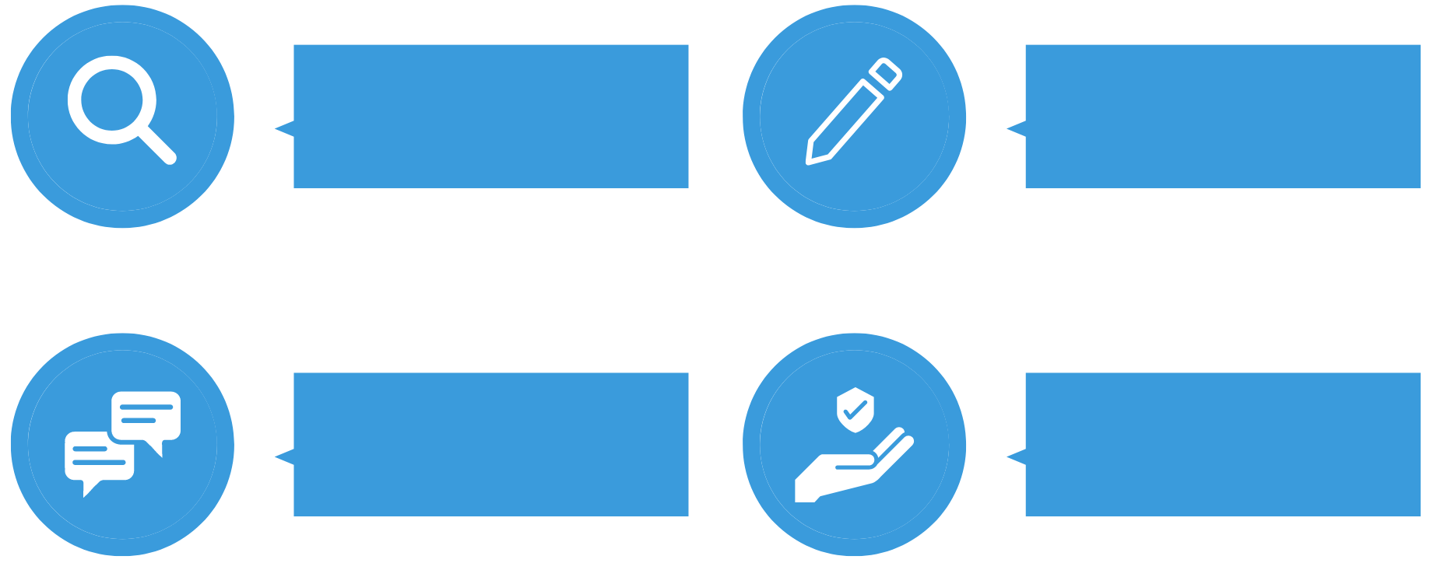
Learning Material Modules
Information &
Data Literacy
Digital Content Creation
Communication &
Collaboration
Safety

Slide 5
01
Introduction & Learning Outcomes
02
Topic 1: Browsing, searching, and filtering data, information, and digital content
Table of
Contents
03
Topic 2: Evaluating data, information, and digital content
04
Topic 3: Managing data, information, and digital content

Slide 6
Introduction
Module “Information & Data Literacy” will introduce the learners the following knowledge and skills:
Articulating information needs, to search for data, information and content in digital environments, to access them and to navigate between them. To create and update personal search strategies;
To analyze, compare and critically evaluate the credibility and reliability of sources of data, information, and digital content.
To organize, store and retrieve data, information, and content in digital environments. To organize and process them in a structured environment.

Slide 7
Learning Outcomes
Module “Information & Data Literacy” outcomes for the learners:
Define & articulate their information needs;
Identify potential information sources;
Select the most appropriate tools to retrieve relevant information;
Understand the characteristics of different tools and construct effective search strategies;
Understand how information is produced, organized and disseminated;
Examine and compare information and sources to determine accuracy, authority, reliability, timeliness, validity, viewpoint or bias, and suitability for their information needs.

Slide 8

TOPIC 1: BROWSING, SEARCHING, AND FILTERING DATA, INFORMATION, AND DIGITAL CONTENT
Browsers and search engines.
Improving search results by using a search engine.
Factors that influence search results.
Internet Browsers vs. Search Machine
By definition, a web browser is a software application. It’s one of the tools you use to access the internet.
A web browser is what allows you to see what you searched for. The browser’s job is to use your internet connection and contact the web page. The web page then sends the data requested, and your browser displays it.
Popular browsers: Google Chrome, Firefox, Microsoft Edge, Internet Explorer, Safari.
What is a search engine?
A search engine is a tool that helps you find the information you need using keywords and phrases.
When you type in your question into the address bar, it’s not the browser that looks for the answer for you. If your address bar doesn’t detect an address or a domain, it automatically searches the web for you.
Watch this video to learn the difference between a search engine and a web browser:
Source: @eHowTech

Slide 9
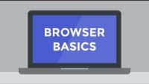
TOPIC 1: BROWSING, SEARCHING, AND FILTERING DATA, INFORMATION, AND DIGITAL CONTENT
Browsers and search engines.
Improving search results by using a search engine.
Factors that influence search results.
Internet Browsers
Some browsers have a default search engine.
For example, Firefox uses Yahoo as its default search engine; Google Chrome uses Google Search as its default search engine. You can change this if you prefer to use a different search engine.
Popular browsers: Google Chrome, Firefox, Microsoft Edge, Internet Explorer, Safari.
Let’s look at the browser’s basics:
Source: edu.gcfglobal.org

Slide 10
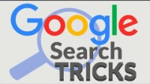
TOPIC 1: BROWSING, SEARCHING, AND FILTERING DATA, INFORMATION, AND DIGITAL CONTENT
Browsers and search engines.
Improving search results by using a search engine.
Factors that influence search results.
Whichever browser and search engine you use, there are ways to get better search results. Here are some tips:
Use keywords in your search.
Ensure that your keywords are spelled correctly; however, search engines like Google Search will try to guess which words you meant.
If you don’t get the results, you are looking for, try changing your keywords.
Use quotation marks if you are searching for a specific phrase. This means the search engine will look for exactly those words in that order.
Essential Google Search Tricks for Research:
Source: www.commonsense.org/education

Slide 11
TOPIC 1: BROWSING, SEARCHING, AND FILTERING DATA, INFORMATION, AND DIGITAL CONTENT
Browsers and search engines.
Improving search results by using a search engine.
Factors that influence search results.
Whether you’re shopping, doing research, or just looking to settle a debate with friends, Google is often the first place we turn to for answers. But finding the information we need can sometimes is hard. There are a few tricks and tips you can use to make your Google search more efficient and effective.
-
Exact Phrase
What it does: searches for an exact wors
What to type: “browser or search engine”
What you’ll get: results that include the exact phrase “browser od search engine”
Excluded Words
What it does: excluded search results with a particular word or phrase
What to type: bass -fishing
What you’ll get: results about bass that are not related to fishing
“ “
Similar Words
What it does: searches for a word and all its synonyms
What to type: ~ mobile phone
What you’ll get: results with the word “phone”, as well as “cell”, “cellular”, “wireless”, etc.
~

Slide 12
TOPIC 1: BROWSING, SEARCHING, AND FILTERING DATA, INFORMATION, AND DIGITAL CONTENT
Browsers and search engines.
Improving search results by using a search engine.
Factors that influence search results.
Whether you’re shopping, doing research, or just looking to settle a debate with friends, Google is often the first place we turn to for answers. But finding the information we need can sometimes is hard. There are a few tricks and tips you can use to make your Google search more efficient and effective.
Multiple Words
What it does: searches for webpages that include either word
What to type: trip Barcelona OR Madrid
What you’ll get: results with words “trip” and either “Barcelona” or “Madrid”
OR
Numerical Ranges
What it does: searches for a range of numbers
What to type: Roald Dahl 1950…1960
What you’ll get: results about Roald Dahl during this period
…
Finding Meanings
What it does: defines a word or phrase
What to type: define: decadent
What you’ll get: links to definitions of the word “decadent”
Define:

Slide 13
TOPIC 1: BROWSING, SEARCHING, AND FILTERING DATA, INFORMATION, AND DIGITAL CONTENT
Browsers and search engines.
Improving search results by using a search engine.
Factors that influence search results.
Whether you’re shopping, doing research, or just looking to settle a debate with friends, Google is often the first place we turn to for answers. But finding the information we need can sometimes is hard. There are a few tricks and tips you can use to make your Google search more efficient and effective.
Site Specific
What it does: searches only particular websites
What to type: global warming site:edu
What you’ll get: references to global warming found on .edu websites
link:
OR
Linked Pages
What it does: searches for websites that link to a particular website
What to type: link:www.umich.edu
What you’ll get: websites that link to the University of Michigan website
site:
Conversions
What it does: converts units of measure
What to type: cm in foot, 28C in F, $ in pound, days in fortnight, miles in league, mph in speed of light, etc.
What you’ll get: the converted answer
Math Answers
What it does: basic calculator functions
What to type: 4+7, 30% of 55, 20^3, sqrt(4), etc.
What you’ll get: the answer
Cm in foot
1+1

Slide 14
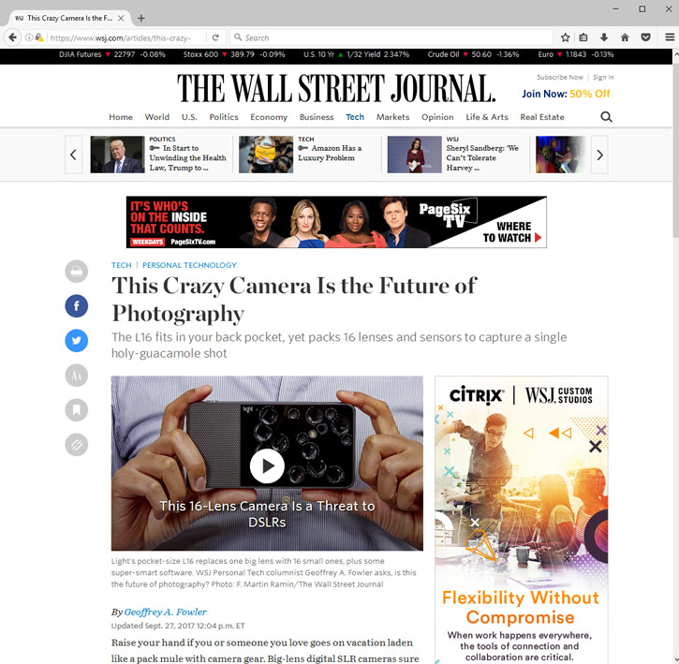
TOPIC 1: BROWSING, SEARCHING, AND FILTERING DATA, INFORMATION, AND DIGITAL CONTENT
Browsers and search engines.
Improving search results by using a search engine.
Factors that influence search results.
The anatomy of a webpage
How to efficiently navigate a webpage to locate the exact information you need on that page, while ignoring any distracting elements that are competing for your attention.
Every webpage is different, but there are some common elements you'll find on most pages. For example, the page might have the main content in the middle of the page, with ads on the left or right side.
Almost every webpage will have some sort of navigation bar that lets you go to other parts of the website.
By learning about some of these basic parts, you'll be able to find the information you're looking for more quickly.

Slide 15
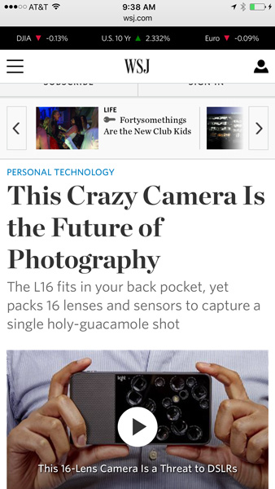
TOPIC 1: BROWSING, SEARCHING, AND FILTERING DATA, INFORMATION, AND DIGITAL CONTENT
Browsers and search engines.
Improving search results by using a search engine.
Factors that influence search results.
Mobile webpages
If you're viewing a webpage on a mobile device such as a smartphone or tablet, you may notice that it has a simpler layout. This is because many sites have mobile versions that are optimized for smaller screens. The website will automatically detect what type of device you're using, and it will display the version that's best suited for that device.
The example below shows the same webpage we looked at above, except it's viewed on an iPhone. The header is now much smaller to make room for the main content (although the mobile site will require a lot more scrolling to read the article).

Slide 16
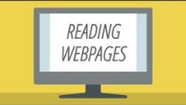
TOPIC 1: BROWSING, SEARCHING, AND FILTERING DATA, INFORMATION, AND DIGITAL CONTENT
Browsers and search engines.
Improving search results by using a search engine.
Factors that influence search results.
Tips for reading webpages and using relevant information in our work
When you're reading a book, you might start at the top of the page and read every word until you get to the bottom. But with a webpage, this usually isn't the best way to read.
Authority
Who is responsible for the page/site?
Is it a reliable organization (e.g., a well-known university) or a subject expert?
Can you trust them?
Accuracy and reliability
Is the information correct?
Are the grammar and spelling correct?
Is it complete, or are they just giving one point of view?
Do they have their own agenda e.g., political organizations?
Is the information fact or opinion?
Is the information backed up by evidence? Is the evidence based on research? Is it reliable?
Currency
Can you tell how up-to-date it is?
Is it regularly updated? You don't want to quote out-of-date information
Reading a Webpage:
Source: edu.gcfglobal.org

Slide 17
TOPIC 1: BROWSING, SEARCHING, AND FILTERING DATA, INFORMATION, AND DIGITAL CONTENT
Browsers and search engines.
Improving search results by using a search engine.
Factors that influence search results.
You can also use the following steps on almost any webpage to help you find a specific information:
Locate the main content. This is usually the most relevant part of the page. On most pages it's easy to find, although you may sometimes have to scroll down to find it.
Make sure you're on the right webpage. If you don't see any relevant information, use the navigation bar or search box to find the page you're looking for. You can also conduct a Google search to find other websites.
Don't read every word. With most websites, you can skim the page to find what you're looking for. To read faster, you can just read the first sentence of each paragraph.
Use headings to help you skim the page. Many online articles have a heading at the beginning of each section. If the heading doesn't seem to be relevant, you can simply scroll down to the next heading.
Ignore ads. Ads are often embedded in an article or disguised as links. They may look like they're relevant, but they usually won't help you find what you're looking for.
Use the Back button. If you've clicked a link that isn't helpful, you can go back to the previous page by clicking your browser's Back button. If the link was opened in a new window or tab, you may need to close it instead of using the Back button.

Slide 18
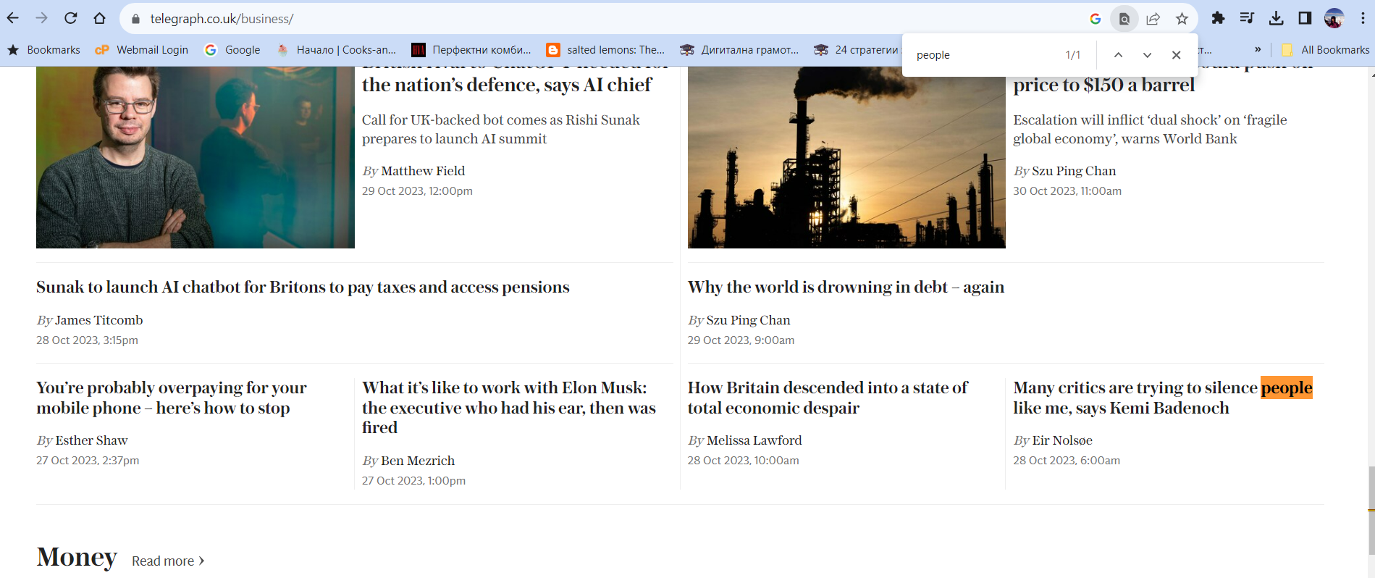
TOPIC 1: BROWSING, SEARCHING, AND FILTERING DATA, INFORMATION, AND DIGITAL CONTENT
Browsers and search engines.
Improving search results by using a search engine.
Factors that influence search results.
Finding a specific word on a page
If you know exactly what you're looking for, you may not have to skim the page.
Hold down Ctrl (or Command if you're using a Mac) and then press F to open the Find toolbar.
You can then type the word or phrase you're looking for to skip to that part of the page. This is especially helpful for long articles.

Slide 19
TOPIC 1: BROWSING, SEARCHING, AND FILTERING DATA, INFORMATION, AND DIGITAL CONTENT
Browsers and search engines.
Improving search results by using a search engine.
Factors that influence search results.
Factors that influence search results.
Search engine algorithms are one of the closest guarded secrets in the world today. There’s a good reason for that. If the full algorithms were available to the public, then many individuals and businesses would game the system and rank their websites much higher than they truly should. That would render search results pretty much useless.
The "best" results have many factors, including things such as the user's location, language, device (desktop or phone), and previous queries. Some of them include:
Content Quality. Quality content is the ultimate ranking factor
Content Uniqueness. It's one thing to have a great piece of thorough, useful and structured content
Fully Crawlable Page
Mobile Optimized Site
Number of Backlinks
Domain Authority
Anchor Text
Site Loading Speed

Slide 20
TOPIC 2: EVALUATING DATA, INFORMATION, AND DIGITAL CONTENT
Types of information and content.
Information literacy and fake news.
Misinformation and disinformation.
Comparing and critically evaluating the credibility and reliability of sources of data, information, and digital content.
Digital content can include text, images, audio, video, animations, interactive features, and more. This type of content can be used for various purposes, such as entertainment, education, communication, marketing, and e-commerce.
Some examples of digital content include E-books, blogs, articles, and newsletters.
Also, digital content may be sponsored - anything that appears in an online publication that is paid for by another company to promote a product or service. Sponsored content usually blends in with the publication's typical message.
Online environments contain all types of information and content including misinformation and disinformation, and even if a topic is widely reported it does not necessarily mean it is accurate.
The importance of identifying who is behind information found on the internet (e.g., on social media) and verifying it by checking multiple sources, to help recognize and understand point of view or bias behind particular information and data sources.

Slide 21
TOPIC 2: EVALUATING DATA, INFORMATION, AND DIGITAL CONTENT
Types of information and content.
Information literacy and fake news.
Misinformation and disinformation.
Verifying and evaluating information – why it is important?
Having access to information at our fingertips is great, but it can also have serious consequences. Accepting everything available online can lead to wrong decisions - whether business or personal.
Whether you're conducting research for an article, working on a school project, or making important decisions based on online information, ensuring its reliability is essential.
By critically evaluating the information you come across, you can make informed decisions, have meaningful discussions, and ensure your choices are grounded rather than assumptions.
Another aspect to consider is the impact of information verification on our personal growth. By actively seeking out accurate information, we expand our knowledge and broaden our perspectives. We become more aware of the world around us and understand complex issues.

Slide 22
TOPIC 2: EVALUATING DATA, INFORMATION, AND DIGITAL CONTENT
Types of information and content.
Information literacy and fake news.
Misinformation and disinformation.
Identifying reliable and unreliable sources
When searching for reliable online sources, there are several key characteristics to look out for:
What is the goal of the site?
Is it trying to convince you of something? Why?
Is the purpose entertainment, monetary gain, political, or educational?
Could that affect the type of information it's providing?
Is it objective or is there bias?
When was the page last updated?
Is it being maintained, or was it put on the web and then forgotten?
Is the information outdated or is it still valid?
Do links still lead to viable sites?
If it's not being updated, how important is it?

Slide 23
TOPIC 2: EVALUATING DATA, INFORMATION, AND DIGITAL CONTENT
Types of information and content.
Information literacy and fake news.
Misinformation and disinformation.
Identifying reliable and unreliable sources
When searching for reliable online sources, there are several key characteristics to look out for:
Take a look at the layout of the page.
Who is it designed to appeal to?
Does it look academic?
Does it contain advertising? Why would a scholarly site include profit-making ads? Who is profiting from these ads?
How did you find this site?
A Google search will find any kind of site, and savvy designers know tricks to get their sites to the top of your results list.
A search in a library-subscribed database will contain items purchased by the library for scholarly purposes. The library website itself links only to sites appropriate for research.
Did you follow an ad to get to it? If they've paid to advertise it, what does this tell you about it?

Slide 24
TOPIC 2: EVALUATING DATA, INFORMATION, AND DIGITAL CONTENT
Types of information and content.
Information literacy and fake news.
Misinformation and disinformation.
What is a sponsored content?
Most advertisements are easy to spot. People quickly recognize them upon sight, and most likely tune them out without a second thought. However, sponsored content blends in with its surroundings so well that unless you look closely, you might never realize you’re looking at an ad.
Sponsored content is an advertisement for a product, service, or brand that is presented as an impartial news article or video. For instance, while reading online news, you may click an article about the condition of women's prisons.
“Paid post” “Presented by” “Sponsored by” “Partnered with” “Promoted” “Affiliated with” “Powered by”
Look familiar? These phrases are indicators of sponsored content. They mean that a brand has spent some money to get some content in front of you.

Slide 25
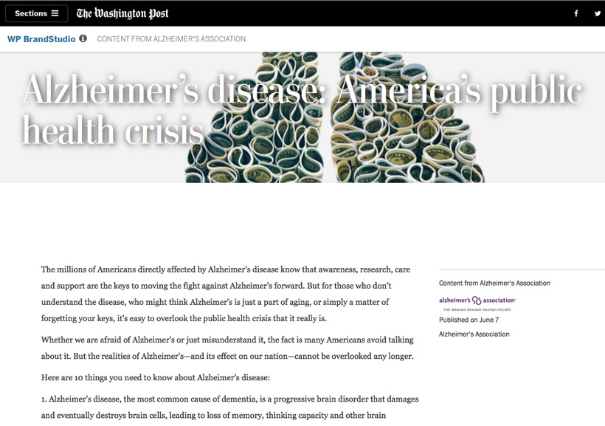
TOPIC 2: EVALUATING DATA, INFORMATION, AND DIGITAL CONTENT
Types of information and content.
Information literacy and fake news.
Misinformation and disinformation.
Where is sponsored content found?
Sponsored content has become widespread online, from BuzzFeed and The Huffington Post to The Wall Street Journal and The New York Times. It’s also prevalent on social media, including Facebook, Twitter, and LinkedIn.
The concern is that sponsored content is so effective at blending in with its surroundings that many people can’t tell the difference between sponsored material and genuine objective content.
According to one study in the United Kingdom, only 31% of 12–15-year-olds could identify the advertisements in Google’s search results, while another study in the United States showed that more than 80% of high school and college students could not tell the difference between a sponsored ad and a legitimate news story.
Let's take a closer look at the byline of this article.
You'll notice the article's content is provided by the Alzheimer's Association.

Slide 26
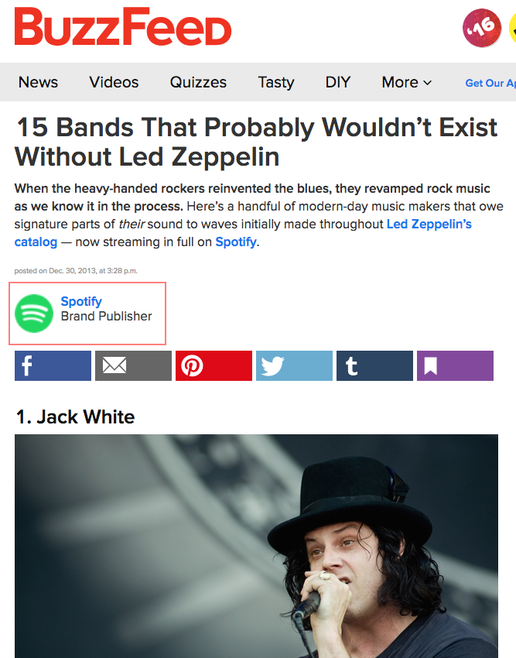
TOPIC 2: EVALUATING DATA, INFORMATION, AND DIGITAL CONTENT
Types of information and content.
Information literacy and fake news.
Misinformation and disinformation.
How can I identify sponsored content?
Sponsored content isn’t necessarily bad, but you should know when you’re reading something that might not be totally clear about its intentions. Check the byline of an article or the description of a video and look for any language that could suggest the content has been paid for. Sites based in the United States are required to add a notice if content has been paid for by an outside company. However, it may be worded in a strange way, like Paid Post, Content from... or Brand Publisher.
The notice may also be disguised within the article or tucked into the fine print. In the image below, you have to read carefully to see the article has been sponsored by Spotify.

Slide 27
TOPIC 2: EVALUATING DATA, INFORMATION, AND DIGITAL CONTENT
Types of information and content.
Information literacy and fake news.
Misinformation and disinformation.
How can I identify sponsored content?
Sponsored content isn’t necessarily bad, but you should know when you’re reading something that might not be totally clear about its intentions. Check the byline of an article or the description of a video and look for any language that could suggest the content has been paid for. Sites based in the United States are required to add a notice if content has been paid for by an outside company. However, it may be worded in a strange way, like Paid Post, Content from... or Brand Publisher.
The notice may also be disguised within the article or tucked into the fine print. In the image below, you have to read carefully to see the article has been sponsored by Spotify.

Slide 28
TOPIC 2: EVALUATING DATA, INFORMATION, AND DIGITAL CONTENT
Types of information and content.
Information literacy and fake news.
Misinformation and disinformation.
What is Misinformation / Disinformation?
The terms “misinformation” and “disinformation” are often time used interchangeably, when in reality they both hold different meanings and connotations. The difference between the two lies in the intent: where “misinformation” is loosely defined as untrue, or semi-truthful content presented as fact, “disinformation” is defined as untrue, or semi-truthful content, deliberately, and often covertly intended to influence its audience.
MISINFORMATION
False or misleading information, unintentionally, presented as fact.
When one believes something is accurate, but in reality, it is not.
DISINFORMATION
False or misleading information purposefully distributed.
When one knows something to be untrue but shares it anyway.

Slide 29
TOPIC 2: EVALUATING DATA, INFORMATION, AND DIGITAL CONTENT
Types of information and content.
Information literacy and fake news.
Misinformation and disinformation.
What is information literacy?
According to the Association of College and Research Libraries, "Information literacy is the set of integrated abilities encompassing the reflective discovery of information, the understanding of how information is produced and valued, and the use of information in creating new knowledge and participating ethically in communities of learning.“
Essentially, this means that information literacy can be seen as how well we do with understanding and evaluating different types of sources, including the news, and how effectively we use that information.
How can information literacy help?
By improving your information literacy skills, you will be better equipped to identify fake news, as well as potential bias in regular news. This will help you be not only a smarter consumer of news, but hopefully a more informed citizen as well. These skills are applicable beyond reading news and will also come in handy when evaluating sources for your research.
This guide can help you learn more about information literacy, provides tools to help you evaluate news sources, and lists many other fact-checking resources.

Slide 30
TOPIC 2: EVALUATING DATA, INFORMATION, AND DIGITAL CONTENT
Types of information and content.
Information literacy and fake news.
Misinformation and disinformation.
What is fake news?
The term fake news alludes to reports, images, and videos that are shared to purposefully spread misinformation i.e., information that is factually incorrect. These news items may appear authentic at first and attempt to attract attention, shock, or shape opinions. Fake news can be created by individuals or groups who are acting in their own interests or those of third parties.
Sensational headlines or political articles used to spread lies and propaganda have been around since the emergence of print media. In times of digital information exchange, fake news has become more of an online phenomenon that is difficult to control. Fake news can reach high levels of visibility in a short amount of time because it’s easy to share via social media and social bots.
Types of fake news: targeted misinformation, fake headlines, viral posts, satire.

Slide 31
TOPIC 2: EVALUATING DATA, INFORMATION, AND DIGITAL CONTENT
Types of information and content.
Information literacy and fake news.
Misinformation and disinformation.
How to spot the fake news?
Consider the source: Click away from the story to investigate the site, its mission and its contact info.
Read beyond: Headlines can be outrageous in an effort to get clicks. What’s the whole story?
Check the author: Do a quick search on the author. Are they credible? Are they real?
Click on those links. Determine if the info given supports the story.
Check the date: Reposting old news stories doesn’t mean they’re relevant to current events.
Check your biases: Consider if your own beliefs could affect your judgement.
Ask the experts: Ask a librarian or consult a fact-checking site.
IS IT A JOKE? If it is too outlandish, it might be satire. Research the site and author to be sure.

Slide 32
TOPIC 2: EVALUATING DATA, INFORMATION, AND DIGITAL CONTENT
Types of information and content.
Information literacy and fake news.
Misinformation and disinformation.
Take the quizzes to check if your aware of fake information on internet!
Fake News Quiz: https://akron.qualtrics.com/jfe/form/SV_2bhqIwpegOtj5yZ
Doubt It or Trust It? https://doubtit.ca/test-yourself/

Slide 33
TOPIC 3: Managing data, information, and digital content
Digital devices and information management.
Organize, store and retrieve data, information,
and content in digital environments.
Working with digital devices and information management.
A digital device is a piece of physical equipment that uses digital data, such as by sending, receiving, storing or processing it.
We rely on them in our personal and work lives for all sorts of reasons. This could be for getting directions, doing our shopping, entertaining ourselves, managing our business stock and finances, or a great many other reasons.
There are different types of digital devices, such as:
Personal Computers
Mobile Devices
Entertainment Systems
Navigation Systems

Slide 34
TOPIC 3: Managing data, information, and digital content
Digital devices and information management.
Organize, store and retrieve data, information,
and content in digital environments.
Personal computers are digital devices that can perform most common computing tasks. That’s why we refer to them as being ‘general purpose’. By installing a new software application our computer becomes capable of performing a completely new function.
They really have a wide range of functions. However, there are some particularly popular uses.
In the workplace, we often use them for word processing, desktop publishing, spreadsheets and database management systems. They’re also popular for creative tasks, like graphics, music and film editing.
This is due to the wide availability of software, good processing capabilities and the range of available input devices. For example, a mobile device doesn’t generally use a keyboard and so isn’t as useful for word processing as a desktop or laptop.
In our personal lives, they’re also commonly used for accessing the internet, such as surfing the web and email. These devices almost always come with networking capabilities which make them useful for this. They’re also used for gaming, but this requires an expensive graphics card normally.
Mobile device is a computing device that is designed to be portable by being compact, light-weight and capable of running for extended periods on battery power. They’re also almost always capable of connecting to the internet wirelessly, either through mobile broadband or Wi-Fi.
Mobile devices, especially smartphones, have become a massive part of people’s lives and are used for all kinds of tasks. Like personal computers, they’re general-purpose devices, and so can turn their hand to most common computing tasks by installing different software applications, or ‘apps’.
The most common use of mobile devices is to access the internet while on the go, such as for web browsing and email access. However, we use them for many other reasons too. Playing games and organizational functions like keeping a diary of events are popular functions we use on a regular basis.
However, as these devices almost always use a touchscreen as the sole input, this makes them not practical for tasks like word processing. Also, the limited processing capabilities make them not practical for graphically intensive tasks like high-end gaming and film editing.

Slide 35
TOPIC 3: Managing data, information, and digital content
Digital devices and information management.
Organize, store and retrieve data, information,
and content in digital environments.
Computing devices that are designed to entertain, such as watching television, listening to music and playing video games.
Examples of entertainment systems include digital media players, mp3 players & video game consoles.
All these devices are used in the home for entertainment. However, this covers a wide range of devices each with their own use.
Digital media players allow us to stream digital media, such as films, tv, music and images from over a network. You may be familiar with devices like Apple TV & Roku. Portable media players are similar, except instead of streaming, we download the media to the device and play it off the devices hard disk.
MP3 players are used to access & listen to 1000s of music tracks on a small portable device. It is now common to have MP4 players which can also play video too. We might also use them to listen to podcasts or other forms of auditory media.
Video game consoles allow you to play video games. We can even use the internet to play games with and against other players from all around the world.
The navigation system is a digital device that uses GPS (Global Positioning System) to provide a real-time map of our current location, as well as including route planning tools to give us directions to a chosen destination.
Often, they also have added features, such as identifying traffic, roadworks and accidents that might delay your journey and take this into consideration to provide an accurate destination time.
An example of a navigation system is an in-car satnav.
In-car satnavs are commonly used instead of traditional maps to help direct you along the fastest route on your car journey. This can be integrated directly into the car’s dashboard but is often in a standalone device. TomTom is a popular brand for these.
Nowadays we often see navigation systems built into smartphones to be used when driving, walking, cycling & taking public transport. For many people, standalone satnav devices have been completely replaced by their smartphones.

Slide 36
TOPIC 3: Managing data, information, and digital content
Digital devices and information management.
Organize, store and retrieve data, information,
and content in digital environments.
What is Data Storage?
Data storage essentially means that files and documents are recorded digitally and saved in a storage system for future use. Storage systems may rely on electromagnetic, optical or other media to preserve and restore the data if needed.
Data storage makes it easy to back up files for safekeeping and quick recovery in the event of an unexpected computing crash or cyberattack.
Data storage can occur on physical hard drives, disk drives, USB drives or virtually in the cloud.
The important thing is that your files are backed up and easily available should your systems ever crash beyond repair.
Some of the most important factors to consider in terms of data storage are reliability, how robust the security features tend to be and the cost to implement and maintain the infrastructure.
Browsing through different data storage solutions and applications can help you arrive at the choice that is the best fit for your business' needs.

Slide 37
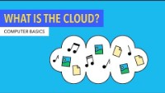
TOPIC 3: Managing data, information, and digital content
Digital devices and information management.
Organize, store and retrieve data, information,
and content in digital environments.
Understanding the cloud
Using cloud storage is becoming more and more common in organizations. In fact, your workplace may already be using a cloud-based product like Microsoft OneDrive, Google Drive, or Dropbox.
Storing files in the cloud essentially means that they are stored on remote servers rather than locally on your computer.
One advantage of cloud storage is that you can free up storage space on your computer. It also makes it possible to access your files from any device connected to the internet.
A potential downside is data security, though cloud storage companies are careful to protect your information.
What is the cloud:
Source: edu.gcfglobal.org

Slide 38
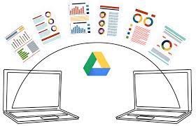
TOPIC 3: Managing data, information, and digital content
Digital devices and information management.
Organize, store and retrieve data, information,
and content in digital environments.
Using Google Drive
Google Drive is a cloud-based storage service that enables users to store and access files online. The service syncs stored documents, photos and more across all the user's devices, including mobile devices, tablets and PCs.
To get started with Google Drive, the user must create or sign in to a Google account. Then, the user types drive.google.com into their browser. My Drive will automatically appear, which can contain uploaded or synced files and folders, as well as Google Sheets, Google Slides and Google Docs files. Then, the user can either upload files from their computer or create files in Google Drive.
Alternatively, the user can download a Google Drive application to one or more devices. A Google Drive folder will appear along with other folders in each device's file system. Files that the user adds to one folder are available through a Google Drive web app or the Google Drive folder on each device.

Slide 39
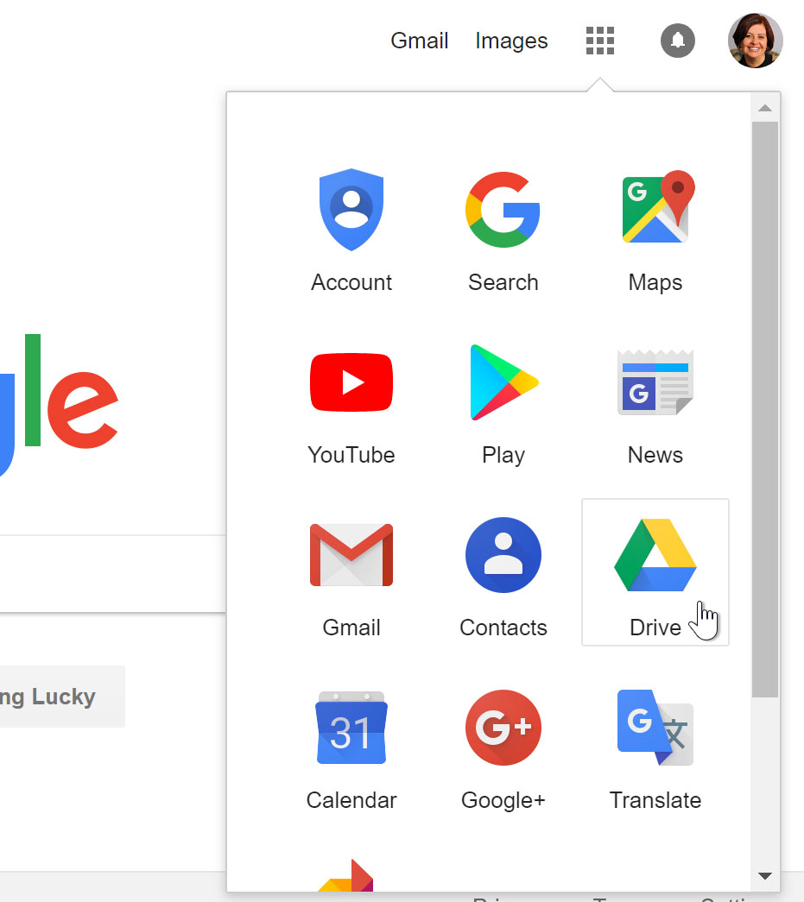
TOPIC 3: Managing data, information, and digital content
Digital devices and information management.
Organize, store and retrieve data, information,
and content in digital environments.
Using Google Drive
Once you've set up your Google account, you can access Google Drive by going to http://drive.google.com in your web browser.
You can also navigate to Google Drive from any Google page (such as Gmail or Google search) by selecting the grid icon near the top-right corner, then clicking Drive.

Slide 40
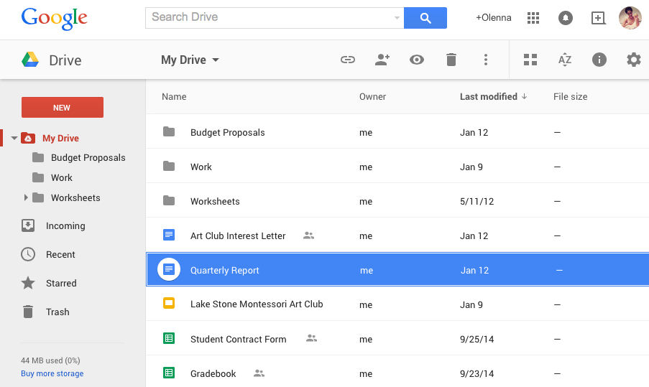
TOPIC 3: Managing data, information, and digital content
Digital devices and information management.
Organize, store and retrieve data, information,
and content in digital environments.
Using Google Drive
Your Google Drive may be empty right now, but as you begin to upload and create files you'll need to know how to view, manage, and organize them in the interface.
Click the buttons in the interactive below to become familiar with the Google Drive interface.

Slide 41
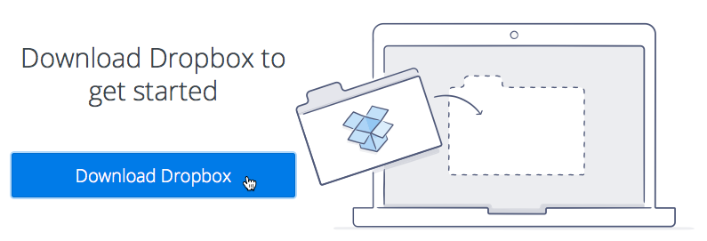
TOPIC 3: Managing data, information, and digital content
Digital devices and information management.
Organize, store and retrieve data, information,
and content in digital environments.
Using Dropbox
Dropbox is a free cloud-based service that lets you store files online and access them anywhere. You can then share these files with other people, allowing them to view, edit, and download them.
Dropbox offers 2 gigabytes (2GB) of free storage space, with options to earn or pay for more.
Dropbox has both desktop and mobile apps and can also be used with any web browser. This means you can access your files from any computer or mobile device connected to the Internet.
And because Dropbox allows you to share files, it makes working with others that much easier.

Slide 42
TOPIC 3: Managing data, information, and digital content
Digital devices and information management.
Organize, store and retrieve data, information,
and content in digital environments.
Using Dropbox
In order to use Dropbox, you'll first need to create a Dropbox account.
Step 1. Go to www.dropbox.com. Locate the sign-up form on the right side of the page and fill in the necessary information, then select the checkbox next to I agree to Dropbox terms and click Sign up for free.
Step 2. A page will appear, prompting you to download Dropbox to get started. Click the Download Dropbox button.

Slide 43
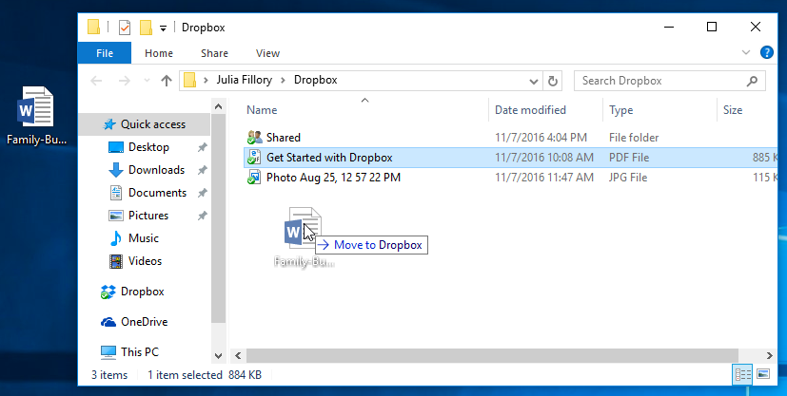
TOPIC 3: Managing data, information, and digital content
Digital devices and information management.
Organize, store and retrieve data, information,
and content in digital environments.
Using Dropbox
Step 3. Run or download the Dropbox installer.
This process may vary depending on your current web browser and operating system.
Step-by-step instructions will appear in the browser window if you're not sure how to proceed.

Slide 44
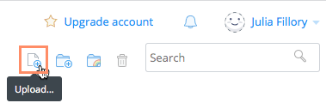
TOPIC 3: Managing data, information, and digital content
Digital devices and information management.
Organize, store and retrieve data, information,
and content in digital environments.
Using Dropbox
Step 4. Once Dropbox has finished installing, the desktop app will appear. Click Open my Dropbox folder.
Step 5. It's easy to upload files from your computer onto Dropbox. If you're using Dropbox's website or their desktop app, you can even upload entire folders. From Dropbox, click the Upload button.
Step 6. A dialog box will appear. Click the Choose files button. Locate and select the file(s) you want to upload, then click Open. You can also upload files by clicking and dragging them into the Dropbox window.

Slide 45
TOPIC 3: Managing data, information, and digital content
Digital devices and information management.
Organize, store and retrieve data, information,
and content in digital environments.
Using Dropbox
Step 4. Once Dropbox has finished installing, the desktop app will appear. Click Open my Dropbox folder.
Step 5. It's easy to upload files from your computer onto Dropbox. If you're using Dropbox's website or their desktop app, you can even upload entire folders. From Dropbox, click the Upload button.
Step 6. A dialog box will appear. Click the Choose files button. Locate and select the file(s) you want to upload, then click Open. You can also upload files by clicking and dragging them into the Dropbox window.

Slide 46
MODULE EXERCISES
Exercise 1:
Go to the Purdue OWL: Email Etiquette page.
Where is the main content?
Where would you click if you wanted to learn how to write an essay?
Exercise 2:
Go to Time's article on bees and pesticides.
Where is the main content? Which parts of the page contain ads?
Which parts of the page link to other pages on Time.com?
According to this webpage, what type of pesticide was found in 75% of honey samples?
Exercise 3:
Visit www.google.com to sign up for a Google account if you don't already have one.
Open Google Drive.
Notice on the left side how much of your storage is used and how much is available.
Try clicking some of the menu options, like Shared with Me and Google Photos.

Slide 47
References & Resources:
www.wikihow.com/
www.youtube.com/@CommonSenseEducation
www.edu.gcfglobal.org
www.youtube.com/@GCFLearnFree
eHowTech. (2013, July 7). Search engine vs. web browser: Tech yeah! [Video].
Google. (n.d.). Better searches. Better results.
www.guides.lib.trentu.ca/tutorials/evaluating_websites
www.blog.collabwriting.com/
www.ionos.com/digitalguide
DoubtIt.ca | Stay Skeptical.
www.uakron.edu/

Slide 48
Information &
Data Literacy
Digital Content Creation
Inclusive digital competence training for labor market risk groups
Communication &
Collaboration
Safety
THIS PROJECT HAS BEEN FUNDED WITH SUPPORT FROM THE EUROPEAN COMMISSION – APPLICATION NUMBER 2022-1-BG01-KA210-VET-000084442. THIS PUBLICATION REFLECTS THE VIEWS ONLY OF THE AUTHOR, AND THE COMMISSION CANNOT BE HELD RESPONSIBLE FOR ANY USE WHICH MAY BE MADE OF THE INFORMATION CONTAINED THREIN.

